Slide 1
Alternate approaches to Factoring Trinomials
The Box-Method and Grouping
By:
Brian D Bedard

Slide 2
Standards and Benchmarks Covered
Standard I.1 Patterns
  Students recognize similarities and generalize patterns, use patterns to create models and make predictions, describe the nature of patterns and relationships, and construct representations of mathematical relationships.
Standard V.2 Algebraic and Analytic Thinking
  Students analyze problems to determine an appropriate process for a solution, and use algebraic notations to model or represent problems.

Slide 3
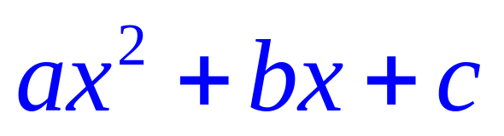

Objective
The purpose of this activity is to engage the learner in different methods of factoring trinomials of the form
by first reiterating how to factor polynomials of the form
using the “ac-test” and the option of learning the box-method and grouping.

Slide 4
Introduction
This StAIR is designed for Mr. Bedard’s Honors Math 2, Algebra 2, Trigonometry/College Algebra and Pre-Calculus classes. You are to navigate through this project alone. There will a short quiz that you can take to work through some problems. Mastery of the alternative approaches to factoring is the goal of this exercise. Very often in life there is not just one way to solve a problem. There is often a multitude of approaches that can yield the same result. This is no different in mathematics and in Algebra. You will consistently be assessed on factoring though-out your mathematical career so count on having factoring problems on future assessments.

Slide 5
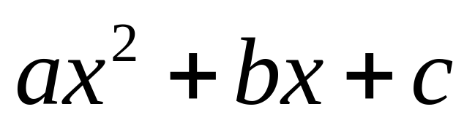
The AC Test Explanation and Examples
Are you ready for more? Click the link below for more difficult scenarios.
Factor by Grouping
The Box Method
Box Method Quiz
Factor By Grouping Quiz

Slide 6

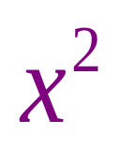
The AC-Test
The ac test is a very important task for factoring.
We use it to know if something is factorable or not.
We will first use it in the trinomials of form
The number 1 is always in front of in this format and we multiply it to whatever “c” is.
Then we find two factors of the product “ac” that will combine to get the value of “b”.
If none exist then it is not-factorable and we are done.
If there does exist two factors then we can move on.

Slide 7
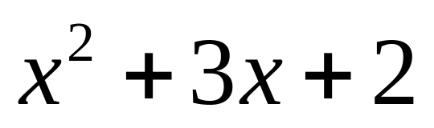
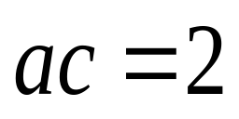
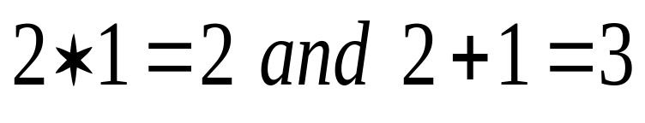
AC-Test Example
Does the following pass or fail the “ac-test” and if it passes what are the two factors?
Click Here for Answer
Since both conditions have been met the following passes the AC-test and can be factorable.

Slide 8
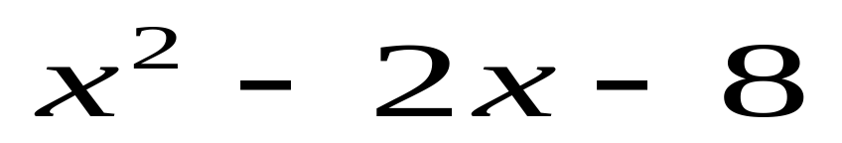
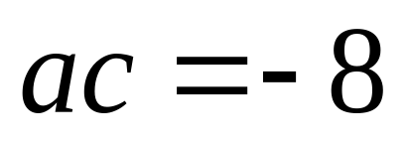
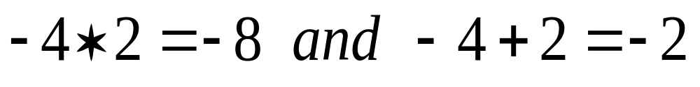
AC-Test Example
Does the following pass or fail the “ac-test” and if it passes what are the two factors?
Click Here for Answer
We are now ready to move on to the alternative approaches to factoring trinomials

Slide 9
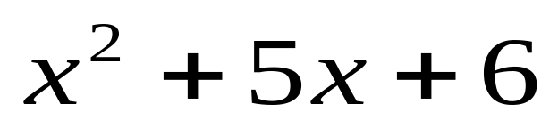
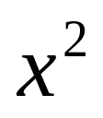
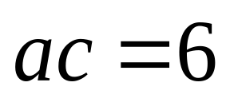
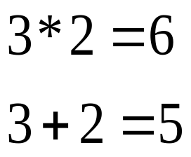


The Box-Method
Determine if the trinomial is factorable.
If it is, put the in the top left box.
Put the “c-value” in the bottom right box.
Place the two factors (it doesn’t matter) in the remaining two boxes with a variable.
Factor each row and column separately.
You now have your factors.
x
 | 3x
2x | 6
+2
x
+3

Slide 10
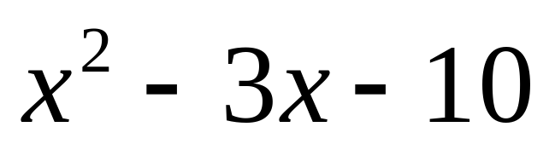
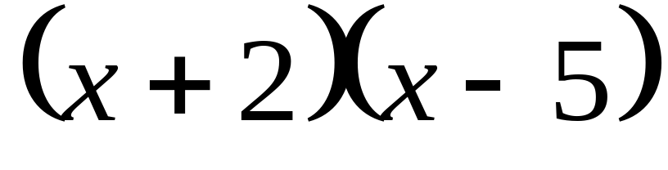
The Box Method Example 1
x
 | 2x
-5x | -10
Is it factorable?
-5
yes
No
x
+2
Yes it is. -5 and 2 multiply to give -10 and combine to give -3.
Quiz

Slide 11
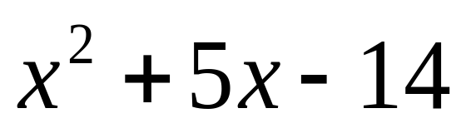
The Box Method Example 2
 | -2x
7x | -14
Is it factorable?
yes
No
What goes in the two missing boxes?
And the factors are?
(x-7)(x+2)
(x-2)(x+7)
(x+7)(x-2)
(x-7)(x+2)
Quiz

Slide 12
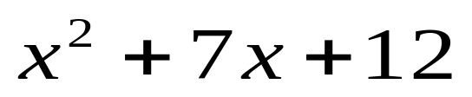
The Box Method Quiz
1. Factor the following polynomial using the box method.
(x+6)(x+2)
(x+12)(x+1)
(x+4)(x+3)
(x+2)(x+6)
(x+3)(x+4)

Slide 13
Not Quite take a second look
Take a look at how you combined your factors!

Slide 14
Did you know that both C and E are correct answers? With multiplication the order does not matter.

Slide 15
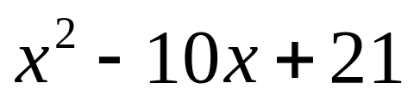
The Box Method Quiz continued…….
2. Factor the following polynomial using the box method.
(x-3)(x+7)
(x-7)(x+3)
(x-3)(x-7)
(x-7)(x-3)
(x+3)(x+7)

Slide 16
Not Quite take a second look
Take a look at how you combined your factors!

Slide 17
Did you know that both C and D are correct answers? With multiplication the order does not matter.

Slide 18
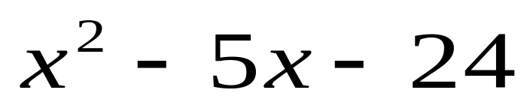
The Box Method Quiz Round 1 Finale
3. Factor the following polynomial using the box method.
(x-5)(x+3)
(x-12)(x+2)
(x+3)(x-5)
(x-24)(x+1)
(x-8)(x+3)

Slide 19
Not Quite take a second look
Take a look at how you combined your factors!

Slide 20
Did you know that E is the only correct answer?
On To Factor By Grouping

Slide 21
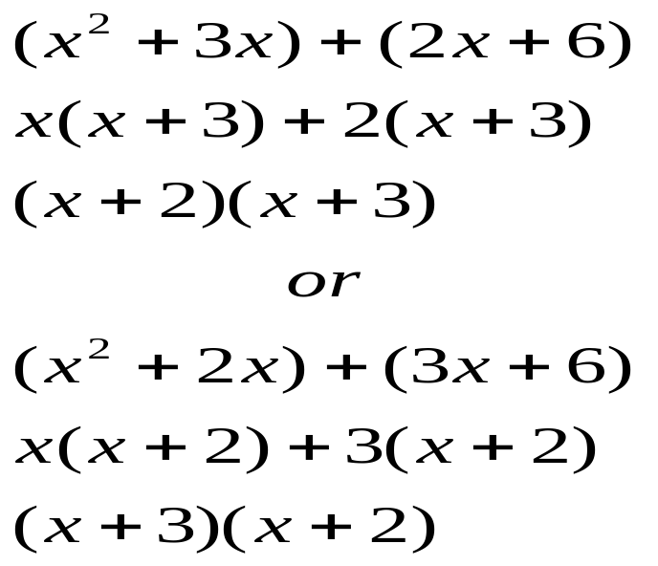

Factor By Grouping Tutorial
Use the AC-Test to determine if it is factorable.
If factorable then find the two factors that multiply to give “c” but combine to give “b” , add an x to it and group them with or c and factor each group.
The two things inside the parentheses in the second step should match.
I have explained it mathematically on the left side of this slide.

Slide 22
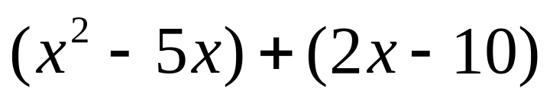

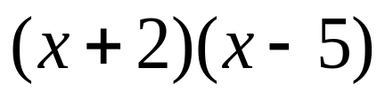
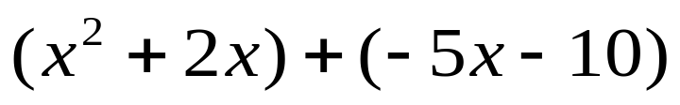

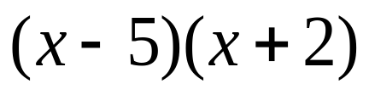
Factor by Grouping Example 1
Determine if the following is factorable?
yes
No
OR
Yes it is. -5 and 2 multiply to give -10 and combine to give -3.
Quiz

Slide 23
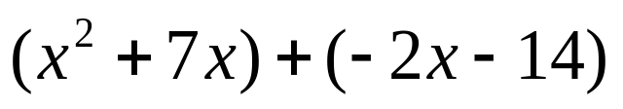
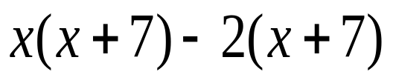
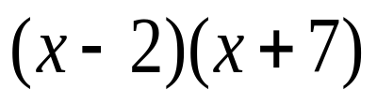
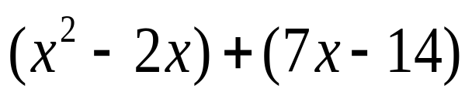
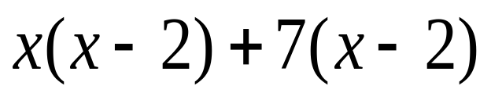
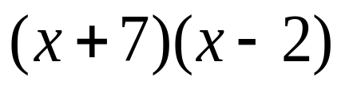
Factor by Grouping Example 2
Determine if the following is factorable?
yes
No
OR
Yes it is. -2 and 7 multiply to give -14 and combine to give -5.
Quiz

Slide 24
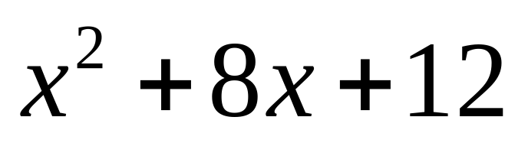
Factor By Grouping Quiz Problem 1
(x-2)(x+4)
(x+2)(x+6)
(x+2)(x+4)
(x+6)(x+2)
(x+2)(x-4)

Slide 25
Not Quite take a second look
Take a look at how you combined your factors!

Slide 26
Did you know that both B and D are correct answers? With multiplication the order does not matter.

Slide 27
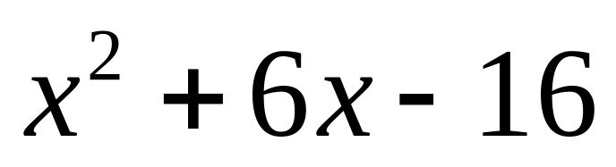
Factor By Grouping Quiz Problem 2
(x-8)(x-2)
(x-4)(x-4)
(x-4)(x+4)
(x+8)(x-2)
(x+4)(x+4)

Slide 28
Not Quite take a second look
Take a look at how you combined your factors!

Slide 29
Did you know that D is the only correct option for this problem.

Slide 30
Factoring More Difficult Trinomials
The nice thing about getting to more difficult trinomials is that all of the steps that you had to do in the other problems you do in these problems.
The numbers are usually larger, which in turns means that there is usually more factors.
Click where you would like to begin.
Factor by Grouping
The Box Method
Box Method Quiz
Factor By Grouping Quiz

Slide 31
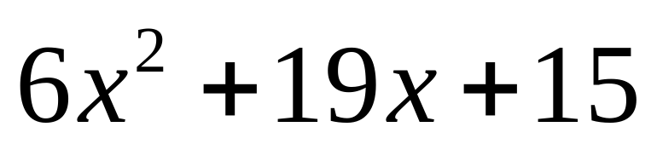
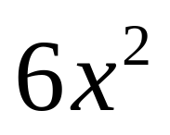
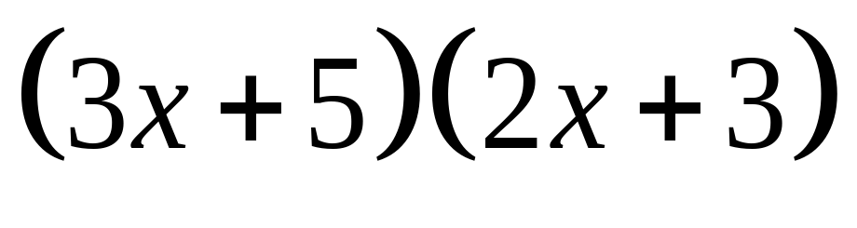
The Box Method Example 2
2x
 | 10x
9x | 15
Is it factorable?
+3
yes
No
3x
+5
Yes it is. 10 and 9 multiply to give
90 and combine to give 19.
Quiz

Slide 32
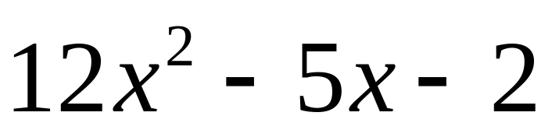
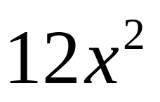
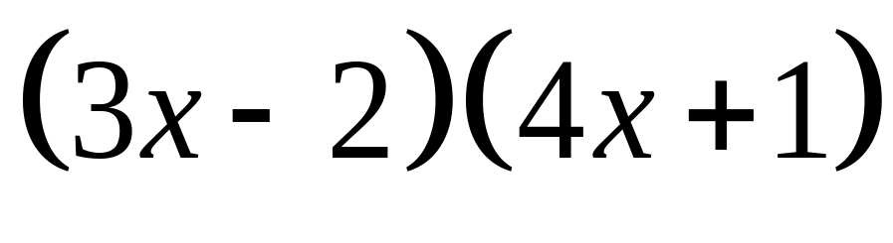
The Box Method Example
3x
 | 3x
-8x | -2
Is it factorable?
-2
yes
No
4x
+1
Yes it is. -8 and 3 multiply to give
-24 and combine to give -5.

Slide 33
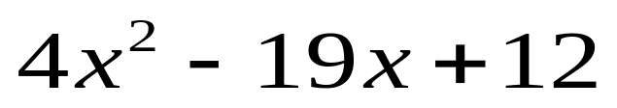
The Box Method Quiz
1. Factor the following polynomial using the box method.
(x-4)(4x-3)
(x+4)(4x-3)
(x-4)(4x+3)
(2x-6)(2x-2)
(2x-3)(2x-4)

Slide 34
Did you know that A is the only correct option for this problem.

Slide 35
Not Quite take a second look
Take a look at how you combined your factors!

Slide 36
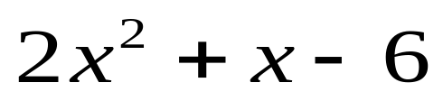
The Box Method Quiz
2. Factor the following polynomial using the box method.
(2x-1)(x+6)
(x-3)(2x+1)
(x-3)(2x+2)
(2x-3)(x-2)
(2x-3)(x+2)

Slide 37
Did you know that A is the only correct option for this problem.

Slide 38
Not Quite take a second look
Take a look at how you combined your factors!

Slide 39
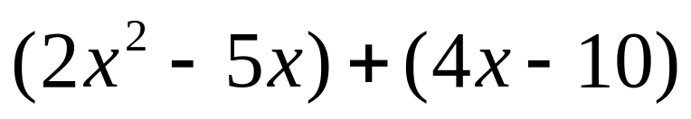

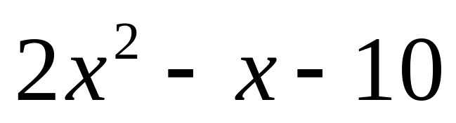
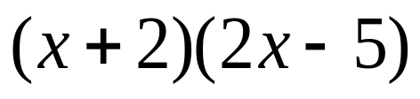
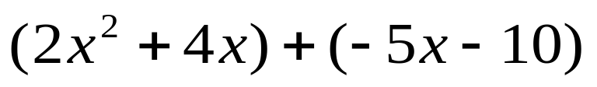

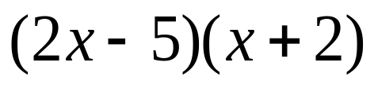
Factor by Grouping Example 1
Determine if the following is factorable?
yes
No
OR
Yes it is. -5 and 4 multiply to give -20 and combine to give -1.
Quiz

Slide 40
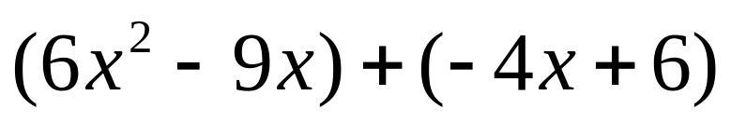

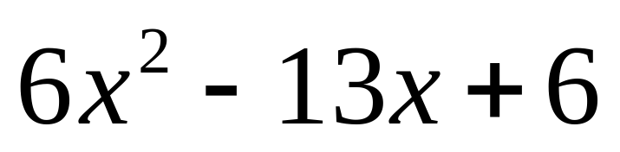
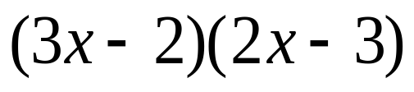
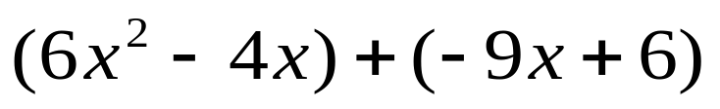

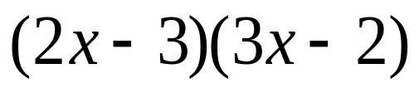
Factor by Grouping Example 1
Determine if the following is factorable?
yes
No
OR
Yes it is. -9 and -4 multiply to give 36 and combine to give -13.
Quiz

Slide 41

Factor By Grouping Quiz Problem 1
(x+4)(2x+3)
(2x+3)(x+2)
(x+6)(2x+1)
(2x+6)(x+1)
(2x+3)(x+3)

Slide 42
Did you know that B is the only correct option for this problem.

Slide 43
Not Quite take a second look
Take a look at how you combined your factors!

Slide 44

Factor By Grouping Quiz Problem 2
(x+1)(10x+3)
(2x+3)(5x+1)
(5x-3)(2x-1)
(x-3)(10x-1)
(5x-1)(2x-3)

Slide 45
Did you know that E is the only correct option for this problem. But (2x-3)(5x-1) would have worked if it was an option.

Slide 46
Not Quite take a second look
Take a look at how you combined your factors and your positive and negative signs!

