Slide 1
Order of Operations
PEMDAS
Notes:
The purpose of the following slide show is impress upon students how just following the order of operations acronym PEMDAS can be detrimental. I feel this lesson works very well when including some humor and excitement. Unfortunately, I have been told by students their former math teachers have told them to always use the order of operations and to follow sally’s directions. This is not always the case and students need to understand why. It is not the most exciting topic but it is extremely important, especially leading into the world of algebra and algebraic equations when students will have to do the inverse order of operations to solve equations.

Slide 2
Please Excuse My Dear Aunt Sally
P
E
M
D
A
S
This is the order we do math operations!! Or is it?
Notes:
Parentheses, exponents, multiplication, division, addition and subtraction. These are the order of operations. Is everything that Sally says to us the truth? Do we solve all problems this way? I will tell you that Sally lies a little bit. She does not tell us the complete truth.

Slide 3
Sally is a liar?
Example
What does Sally say to do first?
What would the next line be if we listen to Sally?
Notes:
Why is Sally a liar? This whole time I have been lied to? This is where I show them why Sally is a liar.

Slide 4
Listening to Sally
Divide
Problem
Multiply
This is not correct!!!!!
Notes:
Sally says to do the multiplication first followed by the division. Aunt sally is not correct. When we have multiplication and division in the same problem, without addition and subtraction separating them, work the problem left to right. Just like we read sentences in the English language.

Slide 5

What we should do!
36
18 3 6
6 6
Notes:
Make sure to hit the sound effect at the end of the explanation.

Slide 6

Putting all the operations together!!!
Treat Addition and Subtraction like stop signs in order of operation problems.

Slide 7
Breaking down large problems into smaller ones
Each underlined item is a term
The terms are simplified
Simplify using PEMDAS
Remember what we discussed about Aunt Sally
Notes:
Whenever we look at a large problem in mathematics we should always ask ourselves what we know how to do? By solving each term individually it breaks a larger more intimidating problem into several smaller more manageable problems. Emphasize Sally’s mistake in the last term.

Slide 8
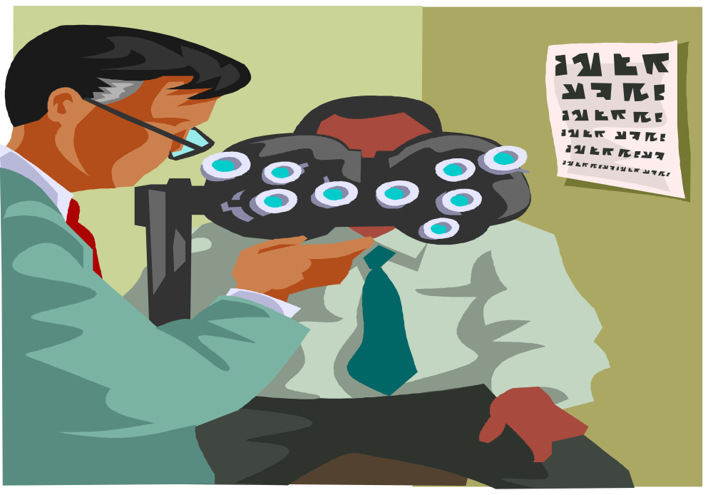
Conclusion
Notes:
Make sure to click the picture first then the speaker or else the speaker will need to be clicked again. PEMDAS is a great acronym to remember. It is extremely useful but it is also extremely important to know and understand when to do division in before multiplication and what we should do last and how we should work problems. Just like the doctor in the picture above is putting things back into focus for the patient we have to do that with ourselves and how we learn. It is more important to understand the rules than to memorize them. If you understand them you will not need to have them memorized and mathematics will come into focus.

