Slide 1

Gleaners of Howell
Nourishing Communities by Feeding Hungry People

Slide 2
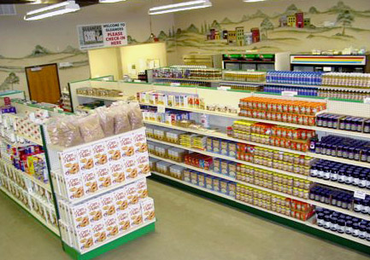
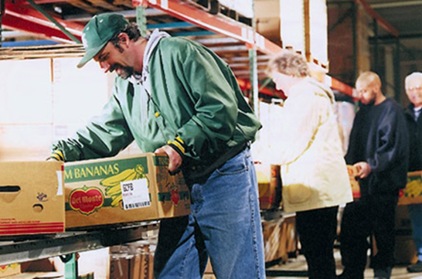
Artifacts
Click Here to learn about the Gleaner’s of Howell Pantry

Slide 3
Artifacts Cont.
A personal story of acceptance and hardship in Livingston County
Hunger Statistics
Everything has a use
Farmers use bread products that weren’t used and exchange them for their products.
Any item that can be salvaged will be

Slide 4
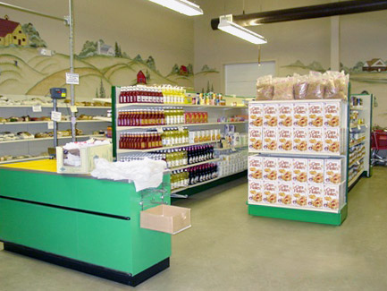
Pantry System
More client dignity and respect
Higher client satisfaction with food, given their ability to select food items of their choosing
Less waste and ultimately less cost of food provided
Greater communities of volunteer and clients to interact; more social, supportive relationship opportunities
Notes:
http://www.gcfb.org/site/PageServer?pagename=pg_sharedpantry_about

Slide 5
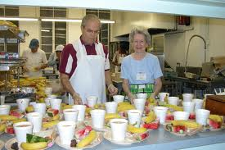
Common Myths about Howell Gleaners
Food is only provided through the pantry system
The only individuals that receive benefits are those that qualify
Food is the only item available

Slide 6
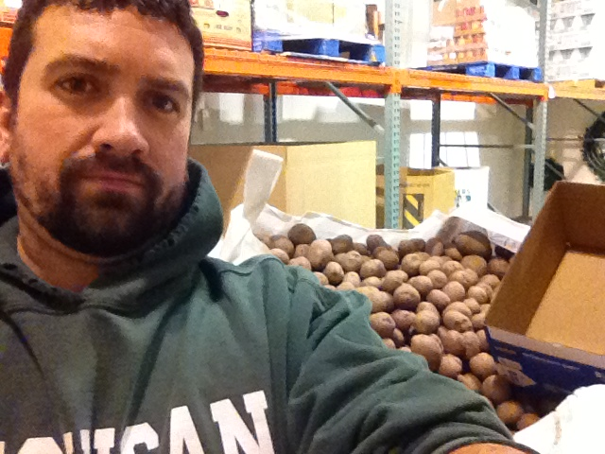
Sorting Potatoes
A pallet about 5 feet high full of potatoes. I sorted the good one into about 10 pound bags. Any of the non used ones were separated into the box on the right.

Slide 7

Values
All people are helped
The pantry is vital to Gleaner’s of Howell
It is a true sense of community a community coming together
Circle of Life

Slide 8

Underlying Assumptions
Hunger affects us all
No one is turned away
We help all we can
Proud to be able to provide so much
Pantry as an integral aspect of the Howell Gleaners
Church and other soup kitchens are helped and a welcomed aspect of what can be provided

