Slide 1
Vision for xxxx High School
Brian Bedard EDLD 620

Slide 2
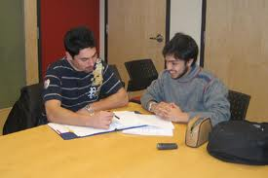
Rigor
A challenging and rigorous curriculum will be provided to all students in all subjects.

Slide 3

The school Community
Learning
All for One!
All staff and students will be provided the necessary support in the learning process.
Each member of the school community is an asset and will be encouraged to find ways to flourish within the school community.

Slide 4

Showcase Success
Students, staff, and faculty members will be challenged to provide opportunities where all individuals can showcase their successes

Slide 5

community
All members of the school community (parents, staff, faculty, students and district members) will be given the opportunity to provide input and suggestions on how best to attain district and school goals.

Slide 6

To infinity and Beyond
Opportunities for students and faculty members to continue their education outside of the classroom will be encouraged and showcased.

Slide 7
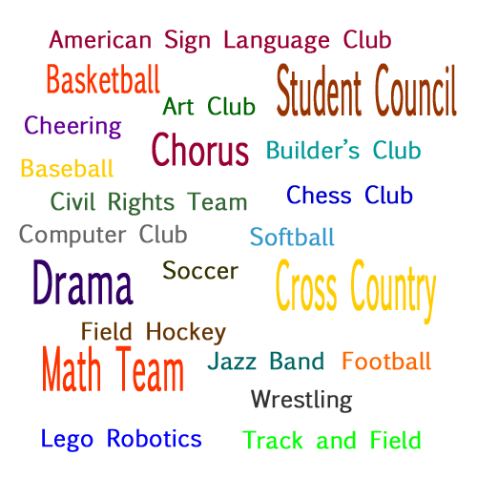
Whole Person
All subjects are important for the success of a student not just those tested on by the state or federal government.

Slide 8

Technology
Faculty members will research the technologies that are being used in colleges, university and the private sector, and provide opportunities to incorporate these technologies into student learning and assessing.

Slide 9

Feedback
Students, parents and school community members will be provided with adequate and timely feedback about student assessments to provide for the opportunity to remedy any issues.

Slide 10
Communication
Communication amongst all members of the school community is vital to the success of the school.
Students
Parents
&
Guardians
Faculty, Staff, and other Shareholders
Positive Communication

Slide 11
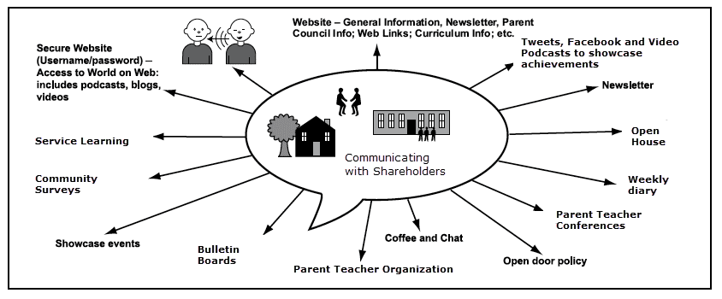
Effective Communication model
80% of Communication is non-verbal We can do more to meet the communication needs of our community

Slide 12
What Can we do?
We serve our community and will continue to do this.
We need to research effective ways to serve.
We need to research effective ways to increase student understanding.
We need to include and invite the community to be involved in the educational process of the school.
We need to research and provide appropriate professional development opportunities for our staff.
We need to communicate with colleges, universities, and employers about their expectations.
We need to use data to drive how we can meet our shareholders needs
We need to celebrate the successes of all members of the school community.

